Slide 1
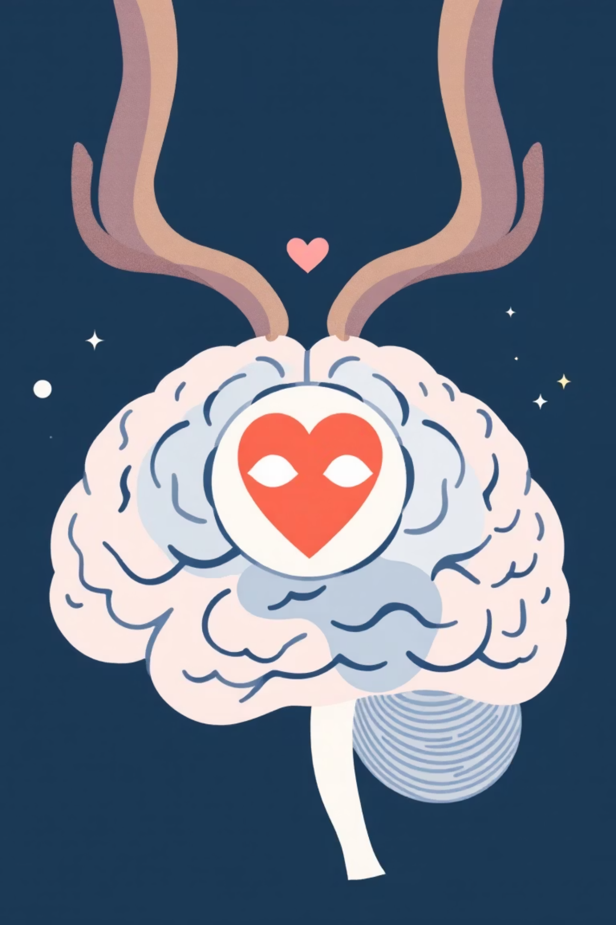
MindMate - AI Mental Health Support
Hackathon-Ready Chatbot
Team: Mental Health Innovators
Date: September 24, 2025

Slide 2

The Mental Health Crisis
25%
60%
24/7
Adults Affected
Untreated Cases
Crisis Moments
1 in 4 adults experience mental health challenges annually
Go without treatment due to cost, stigma, and accessibility barriers
Mental health emergencies don't wait for business hours
The need for immediate, accessible, and stigma-free mental health support has never been more critical.

Slide 3

Our Solution: MindMate
24/7 Availability
Privacy-First
AI-Powered Empathy
Always there when you need support, no appointments required
Anonymous conversations with secure, ethical data handling
Advanced language models trained for compassionate mental health support
MindMate bridges the gap between crisis moments and professional care with intelligent, empathetic AI support.

Slide 4




Key Features
Empathetic Conversations
Crisis Detection
Privacy & Safety
Real-time sentiment analysis identifies crisis situations and automatically escalates to 988 Suicide & Crisis Lifeline
Anonymized logging, resource recommendations, and ethical AI guidelines protect user confidentiality
Powered by advanced LLMs (OpenAI, Gemini, Claude) fine-tuned for mental health support and crisis intervention

Slide 5

Tech Stack
Backend Infrastructure
FastAPI: High-performance async API framework
SQLAlchemy: Database ORM for conversation logging
SQLite: Lightweight, reliable data storage
AI & ML Services
OpenAI GPT-4: Primary conversational AI
Google Cloud NLP: Sentiment analysis
HuggingFace: Mental health classification models
Frontend & Deployment
Streamlit: Rapid prototyping UI framework
Docker: Containerized deployment
Cloud Integration: Scalable infrastructure

Slide 6
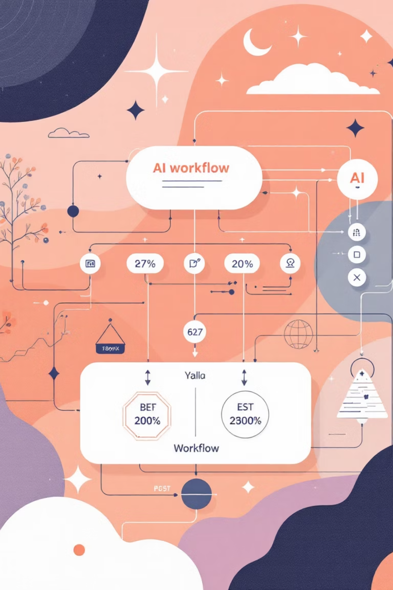




System Architecture
UI Layer (Streamlit)
User-friendly chat interface with accessibility features and crisis resources
API Layer (FastAPI)
RESTful endpoints handling chat requests, authentication, and data validation
AI Logic Layer
NLP processing, crisis detection, safety checks, and LLM response generation
External APIs
OpenAI, Google Cloud NLP, and emergency service integrations

Slide 7

Core Implementation
Chat Endpoint (main.py)
@app.post("/chat")async def chat(request: ChatRequest): sentiment = await sentiment_analyzer.analyze(request.message) if crisis_detector.detect_crisis(request.message): return get_crisis_response() return await llm_client.generate_response( message=request.message, sentiment=sentiment, context=get_user_context(request.user_id) )
Crisis Detection (safety.py)
Keyword matching for crisis indicators
Sentiment threshold monitoring
Automatic escalation protocols

Slide 8

User Interface Design
Chat Interface
Quick Actions
Safety Features
Clean conversation flow with user messages in blue bubbles and AI responses in calming green
One-tap buttons for common needs: "I'm anxious" 😰, "Need resources" 📚, "Crisis help" 🚨
Always-visible disclaimer, sentiment indicators, and immediate access to crisis resources
Responsive design ensures accessibility across devices with high contrast and readable typography.

Slide 9
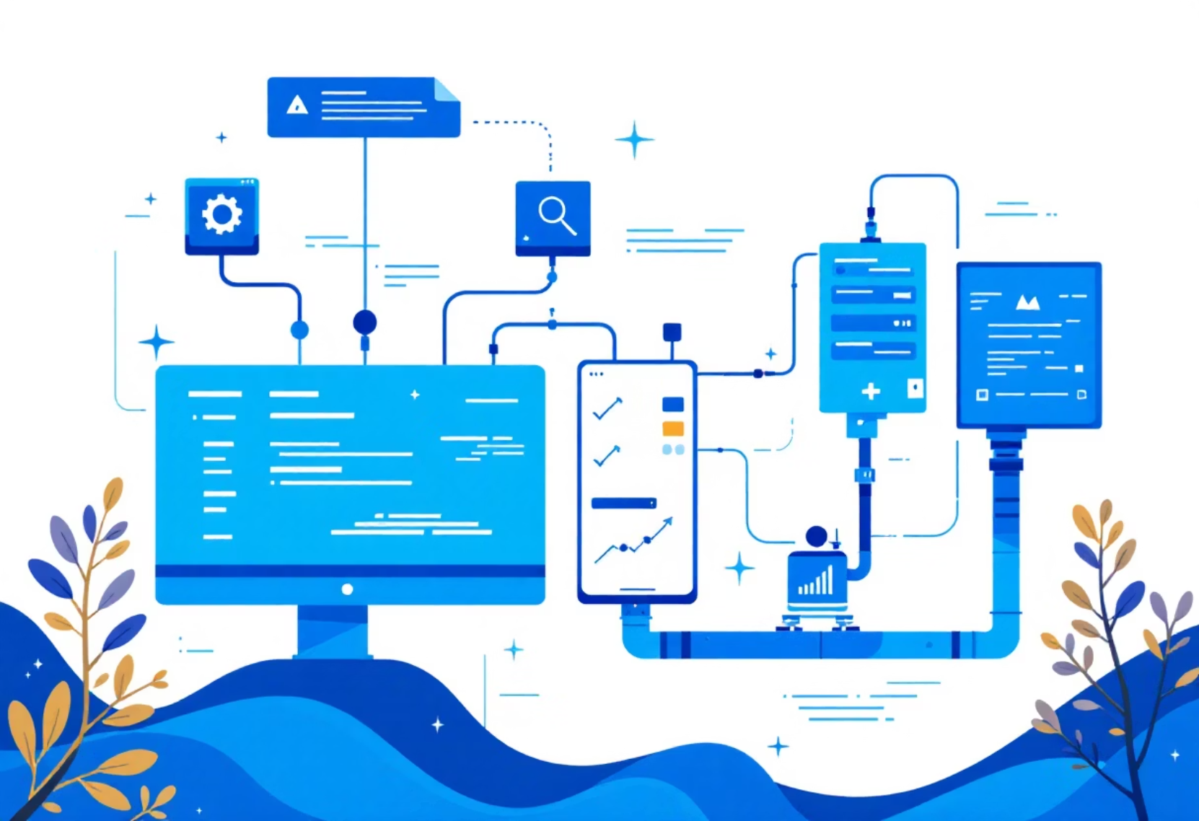
Testing & Deployment
Comprehensive Testing
Pytest Coverage: 90% code coverage
API Testing: All endpoints validated
Safety Testing: Crisis detection accuracy
Load Testing: Concurrent user handling
Deployment
docker-compose up# Local development:uvicorn main:app --reloadstreamlit run app.py
Demo Scenarios
Anxiety support conversation
Crisis escalation protocol
Resource recommendation flow

Slide 10
Impact & Future Vision
<2s
95%
24/7
Response Time
Crisis Accuracy
Availability
Ultra-fast AI responses for immediate support
Precise detection and escalation of mental health emergencies
Continuous support bridging gaps to professional care
Next Steps
Multi-language support for global accessibility
Telehealth platform integration
Advanced personalization algorithms
Contact: striver532006@gmail.com
Questions?

